Slide 1

Adding
Forms
and
Validation
Daniel Villamizar
Senior Cloud Solutions Architect - MVP
@danielvillamizara – https://www.linkedin.com/in/danielvillamizara/

Slide 2


Module
overview
Understanding data binding
Creating a form with input components
Adding validation

Slide 3
Understanding
Data
Binding

Slide 4

<h1
class="page-title">
Details
</h1>
for
@FirstName
@LastName
public
public
string
string
FirstName
{
get;
set;
}
LastName
{
get;
set;
}
Displaying
Data
One-way binding

Slide 5
<input
type="text"
class="form-control-plaintext">
@Employee.FirstName
</input>
public
Employee
Employee
{
get; set;
}
Displaying Data in a
Form Control

Slide 6
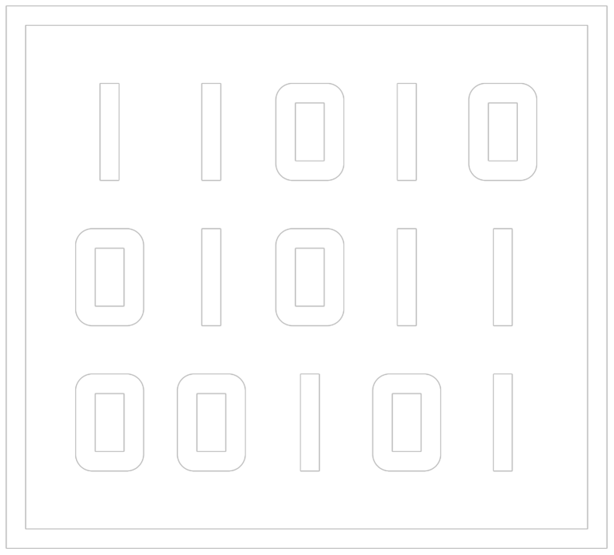
Data
Binding
@bind directive
Can bind to property, field or Razor
expression

Slide 7
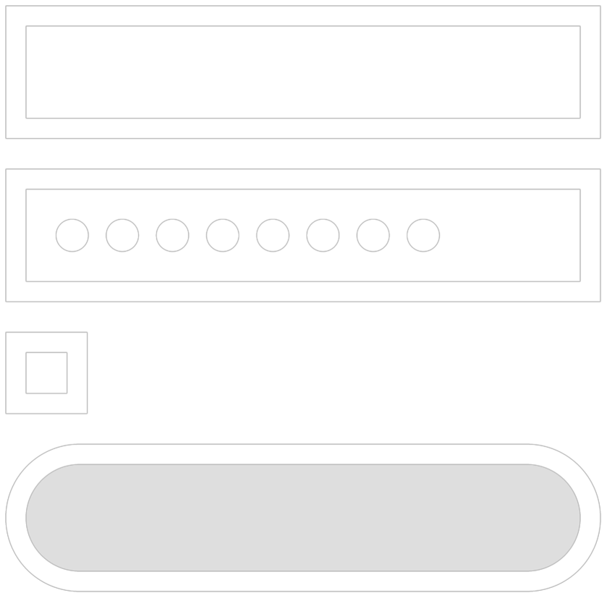
Working
with
a
form
Allowing the user to enter data
Will typically send the data to the API
Use HTML form components or Blazor
form components

Slide 8
<input
id="lastName"
@bind="@Employee.LastName"
placeholder="Enter
last
name"
/>
Data Binding in a Form Control
Using the @bind directive
Data flows in two directions
Triggers when focus leaves the input

Slide 9
<input
id="lastName"
@bind-value="Employee.LastName"
@bind-value:event="oninput"
placeholder="Enter last
name" />
Data Binding on a Different Event

Slide 10


Demo
Working with data binding

Slide 11
Creating
a
Form
with
Input
Components

Slide 12




Forms
in
Blazor
EditForm
Built-in input
components
Data binding
Validation support

Slide 13
A
First
EditForm
<EditForm Model="@Employee"
>
</EditForm>
public
Employee
Employee
{
get;
set;
}
=
new
Employee();

Slide 14

Input components
-
-
-
-
-
-
-
-
-
InputText
InputTextArea
InputNumber
InputSelect
InputDate
InputCheckbox
InputRadio
InputRadioGroup
InputFile

Slide 15



Input
Components
Inherit from InputBase
Basic validation included
(depending on used
component)
Support two-way data binding

Slide 16
Adding
Input
Components
to
the
EditForm
<EditForm
Model="@Employee">
<InputText
id="lastName"
@bind-Value="@Employee.LastName"
placeholder="Enter
</InputText>
</EditForm>
last
name">

Slide 17
Using
the
InputSelect
<InputSelect id="country" class="form-control col-sm-8"
@bind-Value="@Employee.CountryId">
@foreach (var country in Countries)
{
<option value="@country.CountryId">@country.Name</option>
}
</InputSelect>

Slide 18
Submitting
the
Form
OnValidSubmit
OnInvalidSubmit
OnSubmit

Slide 19
Submitting
the
Form
<EditForm
Model="@Employee"
OnValidSubmit="@HandleValidSubmit"
OnInvalidSubmit="@HandleInvalidSubmit">
<InputText
id="lastName"
@bind-Value="@Employee.LastName"
placeholder="Enter
</InputText>
last
name">
<button
</EditForm>
type="submit">Save
employee</button>

Slide 20
Demo
Adding the Add Employee form
Using input components
Editing an employee

Slide 21
Demo
Saving the data

Slide 22
Demo
Adding an image

Slide 23
Adding
Validation

Slide 24
Validation
in
the
EditForm
Data annotations support
DataAnnotationsValidator
ValidationSummary

Slide 25
public
{
class
Employee
[Required]
[StringLength(50,
ErrorMessage
=
"Last
name
is
too
long.")]
public string LastName
{
get; set;
}
=
string.Empty;
}
Applying Data Annotations on the Model

Slide 26
<EditForm
Model="@Employee"
OnValidSubmit="@HandleValidSubmit"
OnInvalidSubmit="@HandleInvalidSubmit">
<DataAnnotationsValidator
</EditForm>
/>
Using the DataAnnotationsValidator
Support for validation using data annotations
Field validation on tab out of the field
Submit of form doesn’t call HandleValidSubmit

Slide 27
<EditForm
Model="@Employee"
OnValidSubmit="@HandleValidSubmit"
OnInvalidSubmit="@HandleInvalidSubmit">
<DataAnnotationsValidator
/>
<ValidationSummary
</EditForm>
/>
Displaying Errors with the ValidationSummary
Errors are only displayed by adding this component

Slide 28
Demo
Applying data annotations on the model
Displaying validation errors in the form

Slide 29
Summary
Forms are based on built-in components
Input components support data binding
Basic validation support using data annotations

Slide 30

Up
next:
Using
JavaScript
from
Blazor

